Slide 1
Balancing housing and jobs
How are LIHTC developments improving the job-housing mismatch?

Slide 2

Suburbanization of Jobs
2000 - 2012
The number of jobs within the typical commute distance for residents fell by 7%
Source: Brookings, 2016
Notes:
In recent years, lower wage jobs relocated to suburban locations given relatively cheap and developable land in the suburbs. But higher-end bedroom communities typically lack housing that is affordable to entry-level and low-income labor force
As a result, number of jobs within the typical commute distance for residents fell by 7%

Slide 3

Disparate Impacts
2000 - 2012
Residents of high-poverty and majority-minority neighborhoods experienced particularly pronounced declines in job proximity
Source: Brookings, 2016
Notes:
This effect is even more pronounced for residents in high-poverty and majority-minority neighborhoods.

Slide 4
Disparate Impacts
2000 - 2012
Residents of high-poverty and majority-minority neighborhoods experienced particularly pronounced declines in job proximity
Source: Brookings, 2016

Slide 5
Disparate Impacts
2000 - 2012
Residents of high-poverty and majority-minority neighborhoods experienced particularly pronounced declines in job proximity
Source: Brookings, 2016
Notes:
So given these trends of increasing mismatch between jobs and housing, do public housing programs reduce this gap?

Slide 6

Shrinking cities rely more heavily on housing subsidy programs
Scranton
Pittsburgh
1950 – 2010
Pittsburgh and Scranton have seen their population decline by 54% and 39%
Source: U.S. Census Bureau
Notes:
In the context of PA, we have two large cities that are shrinking in population.
Pittsburgh and Scranton have seen their population decline by 54% and 39% between 1950 and 2010, creating disinvestment and abandonment.
So housing subsidy programs like LIHTC are critical and can channel resources into distressed communities and increase neighborhood vitality.

Slide 7

Low-Income Housing Tax Credit (LIHTC)
1987 - 2013
Subsidized more than 40k housing development projects and 2.6m households
Source: U.S. Department of Housing and Urban Development
Notes:
Today, LIHTC is the largest resource for creating affordable housing in the United States.
1987 - 2013
Subsidized more than 40k housing development projects and 2.6m households
It now accommodates more households than public housing.

Slide 8
What is the distribution of LIHTC projects in relation to job opportunity in Pennsylvania?
Notes:
Im interested in the distribution of LIHTC projects in relation to job opportunity in PA.
Are housing investments located in areas with employment opportunities? How has this relationship changed over time, as socioeconomic conditions change?

Slide 9



Target Audience
State agencies
Housing/social justice advocacy groups
General public
Notes:
My goal is to improve siting of LIHTC development projects so my target audience would be:
State agencies, as they are responsible for allocating tax credits
Housing and social justice advocacy groups so they can better understand the impacts of location of LIHTC developments
Members of the public, to improve the dialogue regarding housing subsidy programs

Slide 10
Visualizations help illuminate changes over time
Notes:
Location of Good jobs, just like housing that is affordable, is not static over time. So visualizations can help us see how these change over time.

Slide 11
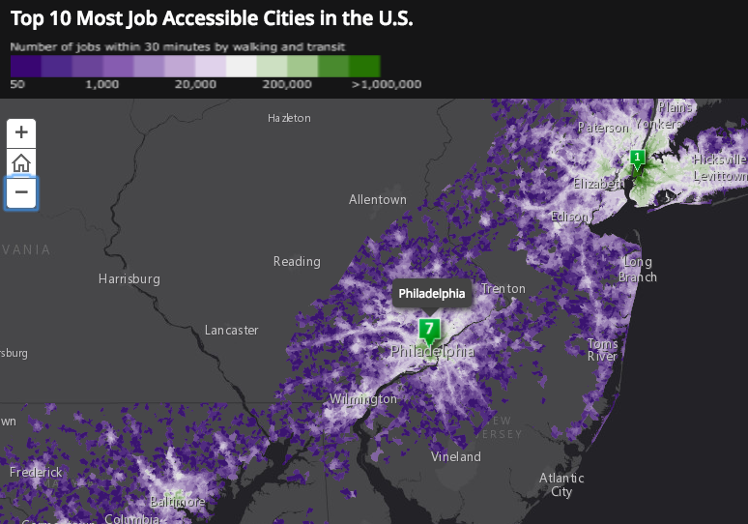
Jobs within 30 minutes of walking or transit
JENNIFER D. BELL

Slide 12
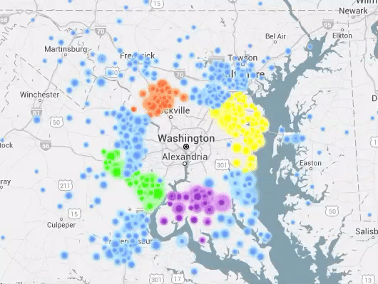
Commuters traveling to jobs in D.C.
MARK EVANS
Source: http://bigbytes.mobyus.com/commute.aspx

Slide 13
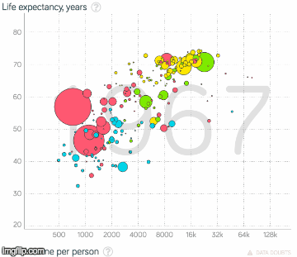
Change in life expectancy and per capita income by country
GAPMINDER

Slide 14
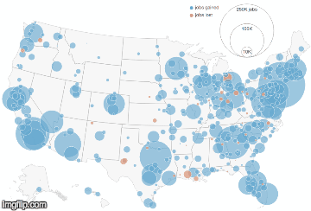
Geography of jobs by month
TIP STRATEGIES

Slide 15

Rhythm of food
GOOGLE

Slide 16
Notes:
Location of Good jobs, just like housing that is affordable, is not static over time. So visualizations can help us see how these change over time.

Slide 17
Notes:
Location of Good jobs, just like housing that is affordable, is not static over time. So visualizations can help us see how these change over time.

Slide 18
LIHTC housing more likely to be in low-income and minority neighborhoods
44%
1995 – 2006
of all tax credit units are in tracts with over 50% minority population, compared to 32% for all rental housing
Notes:
21% of all LIHTC units put in service from 1995 through 2006 are in census tracts where over 30% of the residents are below the poverty line, while 12% of all rental units are in the tracts.
Although tax-credit housing is more concentrated within minority and low-income neighborhoods than is other rental housing, it is much less concentrated in these neighborhoods than is public housing and other project-based federal housing subsidies

